Slide 1



Wireless Innovations Improving Productivity
2
CORRECT ISSUES
Immediate Communications
DISPLAY ISSUES
Visual Display Software
VT3000
Innovative
Wireless System
For the Production Floor
WWi
1
ANALYZE ISSUES
Graphs and Reports
PREVENT ISSUES
Corrective Action
Improved Productivity
Additional Production Output

Slide 2





Benefits Customers Have Realized
ON TIME DELIVERY IMPROVEMENT
Improved On Time Delivery from 81% to 97%
Mexicali Operation
REDUCTION IN DOWNTIME
Documented 10% to 12% Reduction in Downtime Directly Related to VersaCall Andon System
Corporate Wide
DOWNTIME TURNED INTO PRODUCTION TIME
Increase Production Time 8 Hours Over a One Month Period
Engine Plant
ROOT CAUSE VISIBILITY
Provided Corrective Action Visibility 70% of Issues Related to Material
Rockford Il Operation
Factory Floor Communication • Andons • Real Time Performance Screens • Visual Factory • Automated Data Capture • OEE

Slide 3
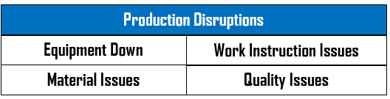
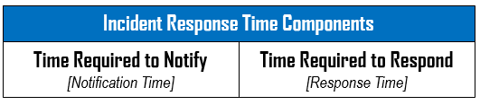
Calculating a Financial Return – 2 Simple Steps
Step 1
Determine the Number of Production Disruptions Over a Production Time Period & the Number of Individuals Impacted
Reasonable Estimates of the Number of Production Disruptions Over a Production Shift, Day, Week, Can Be Substituted if Production Data Is Not Available
Step 2
Determine the Current Average Response Time for Each Incident
Reasonable Estimates of Average Response Times Can Be Substituted if Data Is Not Available
Conservatively An Andon System Has Proven to Reduce Incident Response Time by 35% to 40%
Factory Floor Communication • Andons • Real Time Performance Screens • Visual Factory • Automated Data Capture • OEE

Slide 4
Sample Calculation of Payback Due To Reducing Response Time
Step 1
Number of Downtime Incidents by Shift / Day – 35
Step 2
Average Response Time Per Incident – 15 Minutes per Incident
Calculation:
35 Incidents x 15 minutes = 525 minutes of downtime due to response time per day [8.75 Hours]
Additional Production Hours Per Day – 3.0 hours [ 8.75 Hours x 35% ]
Per Week - 15 hours
Per Month - 61 hours
fdddd
Monthly Payback Realized $12,200
61 hours x $200/hour
Factory Floor Communication • Andons • Real Time Performance Screens • Visual Factory • Automated Data Capture • OEE

Slide 5
Financial Return – Payback 2 to 6 Months
Financial Paybacks Are Realized From:
Reducing Downtime – Immediate Communications of Issues
Reducing Set-Up Time
Automated Data Collection
Real Time Monitoring of Production Status – Identifying Abnormalities
Customer Example –System & Payback
VT3000 System - $14,100
    Control Unit [Server] with Receiver
    10 Input Modules
    1 Repeater
    Large Screen Display Software
    2 Way Radio Transceiver
Financial Payback – 3.2 Months (Annual Return $37,500)
    30 Incidents [10 Per Shift] – Total Plant – All Shifts - 4 Minute Savings Per Incident
    3 Employees Affected Per Incident
Templates at Available For Calculating ROI
Factory Floor Communication • Andons • Real Time Performance Screens • Visual Factory • Automated Data Capture • OEE

Slide 6
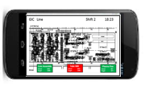
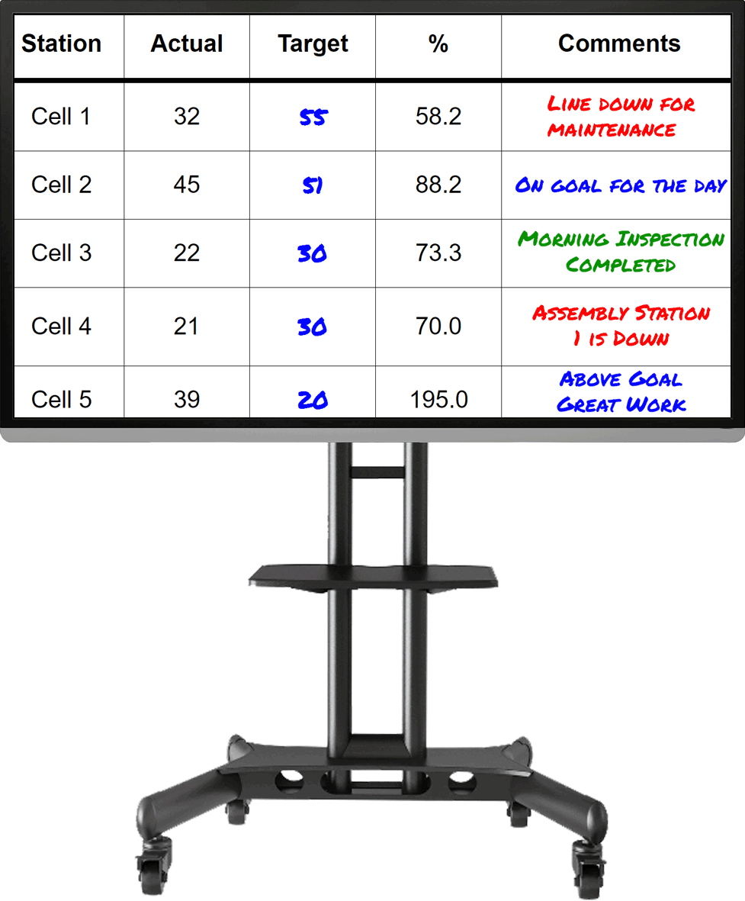
Eliminate Production Looses
Recover Lost Production Time
      Minimizing Production Disruptions – Reduce Downtime
      Identifying & Immediately Correcting Production Abnormalities
      Immediate Communications of Production Issues
Visual Management
      Performance Feedback to Line Operators
      View Equipment or Production Station Status
      View Line Status & Plant Status
      Enterprise Status
Easily Identify Process Bottlenecks/ Areas for Improvement / Track Week to Week Improvements
Automatically Capture Performance Data
Significantly Improving the Accuracy /Timeliness/Consistency/Completeness of the Data
Factory Floor Communication • Andons • Real Time Performance Screens • Visual Factory • Automated Data Capture • OEE

Slide 7
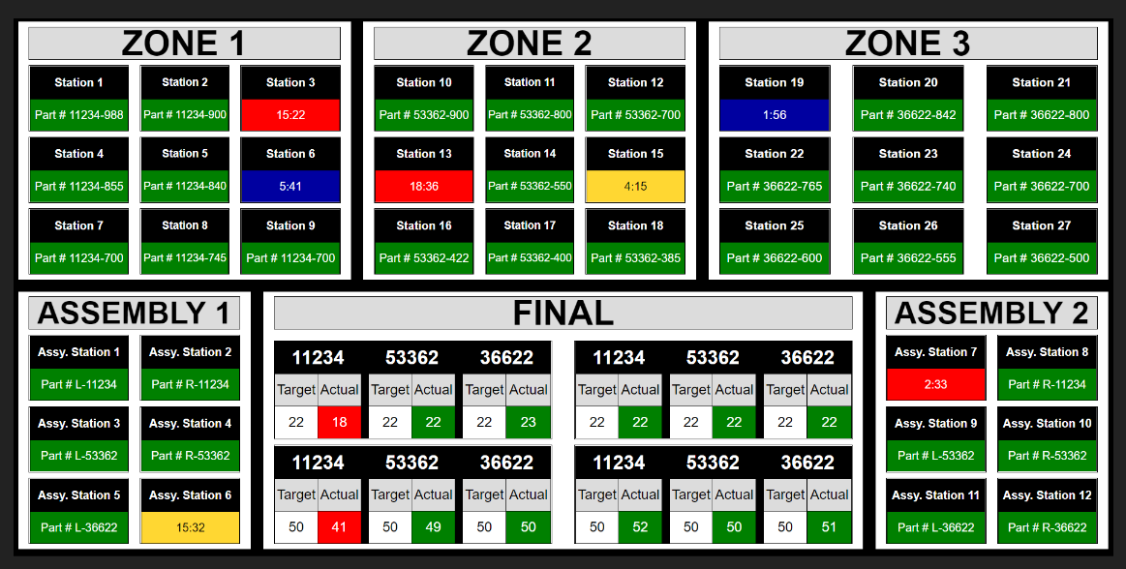
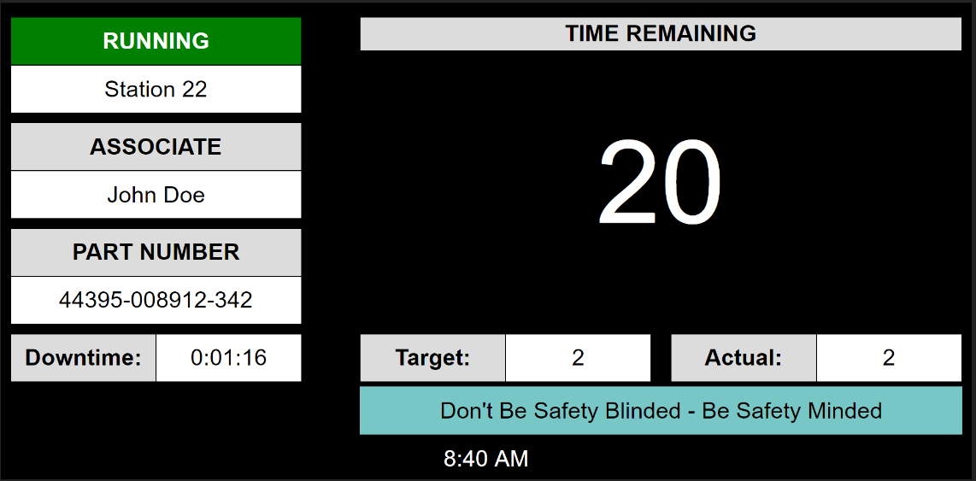
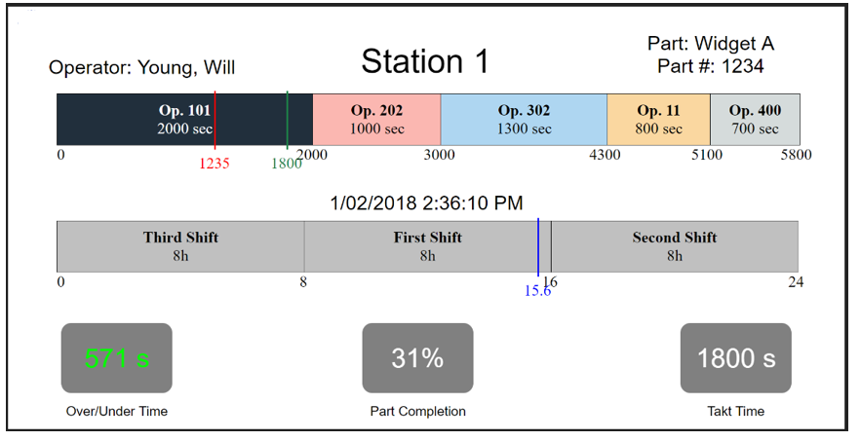
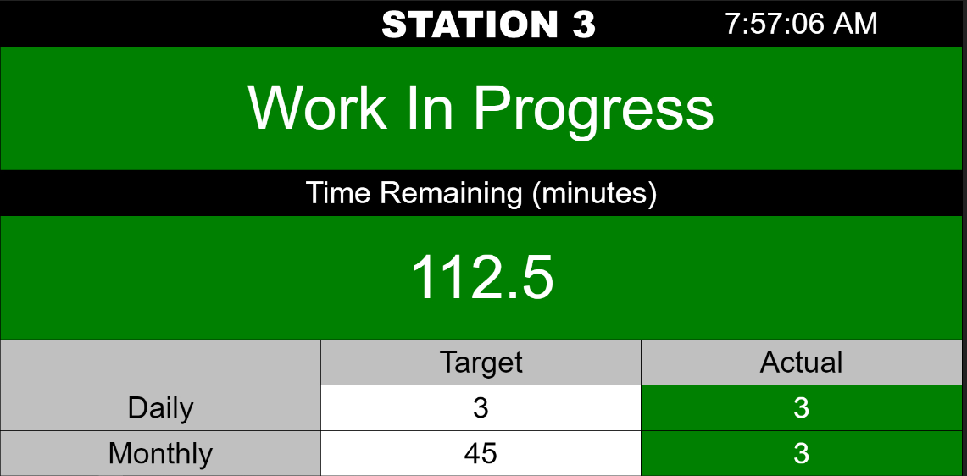
Clear - Concise – Complete Visual Status Visibility
Total Plant Status
Drill Down To Individual Station Status – Define the Appropriate Format

Slide 8












VersaCall’s Customer’s include …
Factory Floor Communication • Andons • Real Time Performance Screens • Visual Factory • Automated Data Capture • OEE

Slide 9



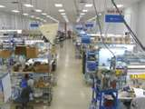
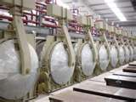

Supports All Manufacturing Environments
Machine Centers
Moving Assembly Lines & Stationary Assembly Operations
Packaging Line
Cell Manufacturing
Process Flow Lines
Production Lines
Factory Floor Communication • Andons • Real Time Performance Screens • Visual Factory • Automated Data Capture • OEE

Slide 10

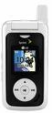
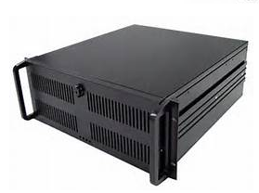

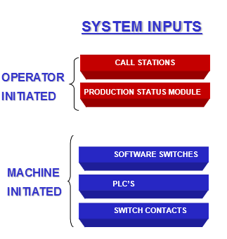
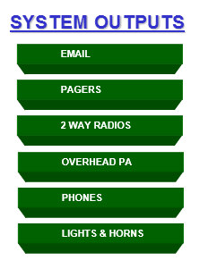
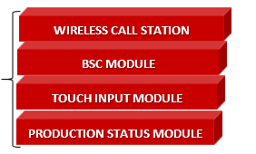
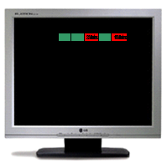
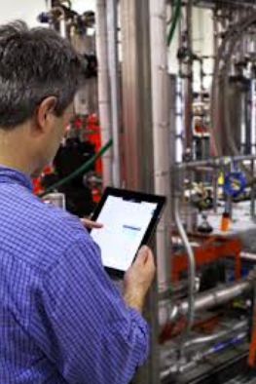

System Overview
1
System
Repeater
Wireless
Powered
System
Receiver
Input
Modules
VT 3000 Std Control Unit / Server
TOUCH INPUT MODULE
REAL-TIME SCREENS
SMART PHONES, TABLETS
& REPORTS
Factory Floor Communication • Andons • Real Time Performance Screens • Visual Factory • Automated Data Capture • OEE

Slide 11
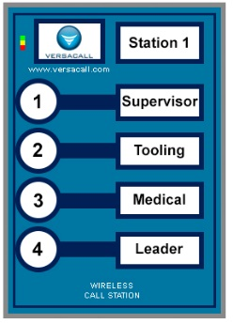
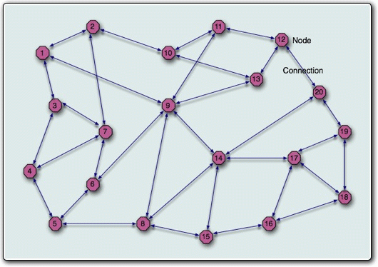
Call Station Input Module
Call Station - Battery or Powered
    Captures Response Time to Issues
    Introduces a Whole New Concept of Support Accountability
    Also Escalates and Routes Messages Until Acknowledgement
    Every Request for Support is Logged in Database [Time and Date Stamped ]
    Provides Visibility of Support Personnel Response Performance to the Production Floor
    Innovative Zigbee Wireless “Mesh” Technology
    NEMA 4-sealed housing / Membrane Switch Buttons
    Contains 4 Switch Contacts
    Up to 1,500 Units per System – 6000 Monitoring Points in Control Unit [Server]
    Communication Path for Each Individual Button is Programmable
DigiMesh Technology Forms
It's Own Network
Factory Floor Communication • Andons • Real Time Performance Screens • Visual Factory • Automated Data Capture • OEE

Slide 12
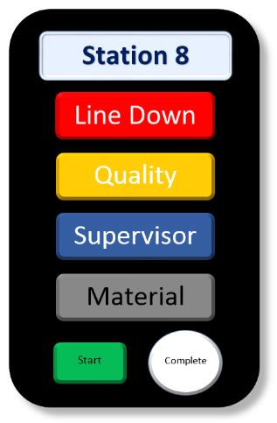
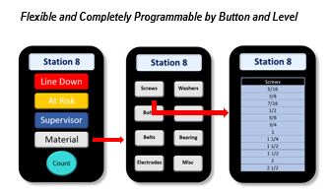
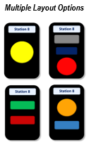
BSC Input Module - Flexible and Simple
BSC Module – Programmable Buttons
Choose Button Type, Color, Size & Quantity
Flexible Layouts
Programmable
Link Multiple Screens
Immediate Communications
Simple & Flexible
I/O Module
Touch Screen
Factory Floor Communication • Andons • Real Time Performance Screens • Visual Factory • Automated Data Capture • OEE

Slide 13
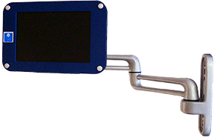
Touch Input Module - Visual Status Indicators
Touch Input Module – 7” Screens
Programmable & Configurable Touch Screen Displays
Number of Individuals to Call – Programmable 20+
Immediate Communications -Response Time & Escalations
Captures Counts & Downtime With Reasons
Full Touch Screen Keyboard & Key Pad
Factory Floor Communication • Andons • Real Time Performance Screens • Visual Factory • Automated Data Capture • OEE

Slide 14
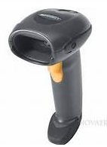
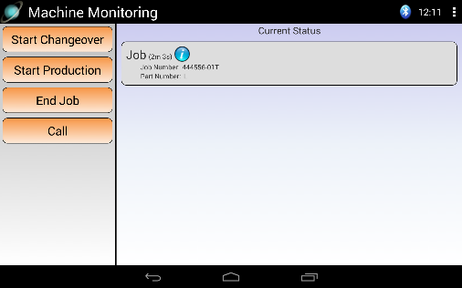
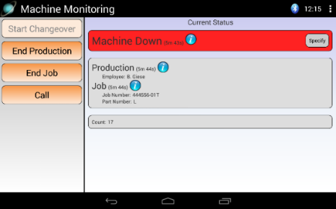
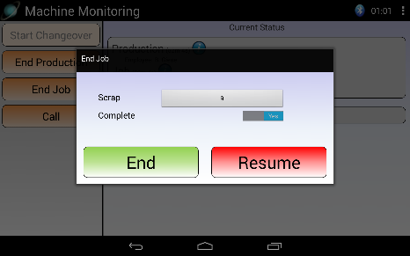
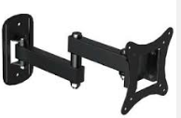
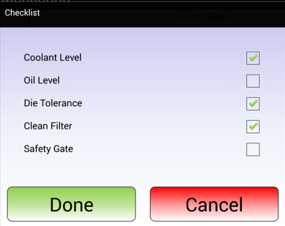
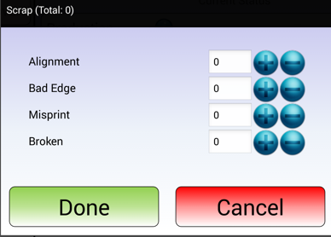
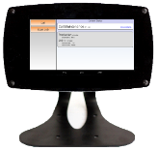
Production Status Module – Touch Screen [10” Screen] & I/O Module
Module Features
Configurable Touch Screen Display
Captures the Responding Individual w/ NFC Technology
Module Retrieves Data for Look Up List
Wireless Configuration Set-Up & Changes
Supports Wireless Bar Code Scanners
Clear Alarms/Actions from Different Modules
Full Communication Capabilities
Full Touch Screen Keyboard & Key Pad
Completely Configurable Screens
VESA Mounting Patterns Supports
Multiple Stand Options
Equipment
Mounts
Articulating Arms
Bench Stands
Floor Stands
Factory Floor Communication • Andons • Real Time Performance Screens • Visual Factory • Automated Data Capture • OEE

Slide 15
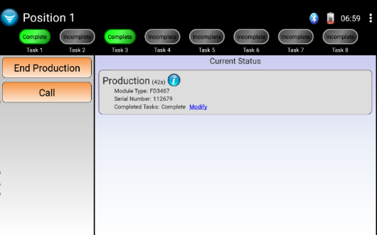
Touch Input Modules
Touch Screen Applications
Verification of Certified Operator or Trained Operator
  Verifies that the operator has been trained on the equipment . Can Set-Up so Operator Must Perform Function Before Starting Equipment. Can have immediate communications to floor supervisor when there is an issue.
Check List
Can Set-Up so Operator Must Perform Function Before Starting Equipment.
Can be a Dynamic List –Change by Location or Station or Part Number
Request Material Including Quantities
Operator Pushes “Material Button” – List appears & operator select the material required. Material List is can be a
“Dynamic List” - it can be different by locations or Part Number being produced. Options to request the quantities required.
Run Jobs or Production Runs In Sequence
Production runs or job numbers that are to be run are loaded into the system by line management. Job sequence is shown on the touch screen.
Touch Screen Programmable Indicator Status
8 Programmable Indicator Status On the Screen - Each Screen Can Have It’s Own Indicators – Colors Change to Reflect Status
Factory Floor Communication • Andons • Real Time Performance Screens • Visual Factory • Automated Data Capture • OEE

Slide 16
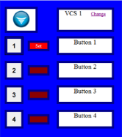

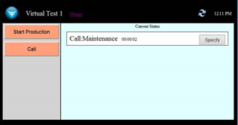
Additional Modules
1Computer Screen Modules
PC Modules
For LAN Connected PC’s
Touch Screen or Mouse
PC Call Station
Add’l Buttons Can Be Added
PC BSC Module
Completely Configurable
PC Input Module
Flexible –Layout Completely Configurable
Wireless Switch Contact Module – Input Module
Unit
Wireless Controls Module
1Wireless
Simple Inputs
Normally Open/Closed
Fully Programmable
1Wireless Activation
Lights
Horns
Speakers
Inputs Can Control Outputs
Program remotely
Moving Assembly Module
I / O Module
1Wireless
Full Communications
Simple to Use – One Button to Signify Work Complete
Captures Assembly Performance within Assembly Line
Automatically Resets
Repeater
1Wireless
Machine Interface
4 Inputs
7 Outputs
Inputs Can Control Outputs
Factory Floor Communication • Andons • Real Time Performance Screens • Visual Factory • Automated Data Capture • OEE

Slide 17
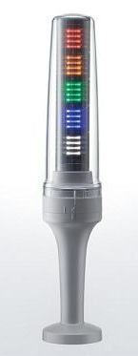
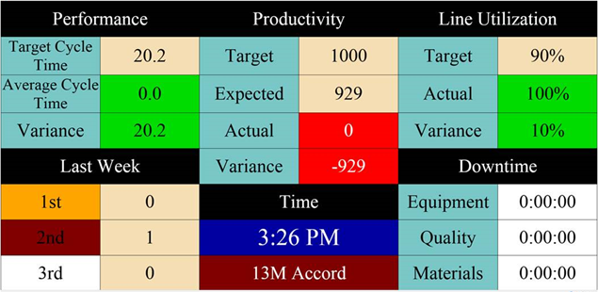
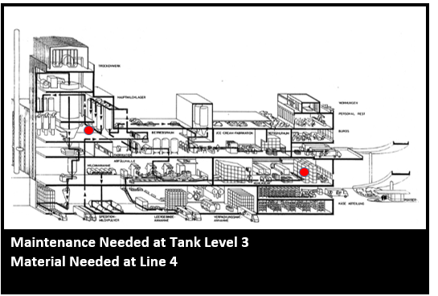
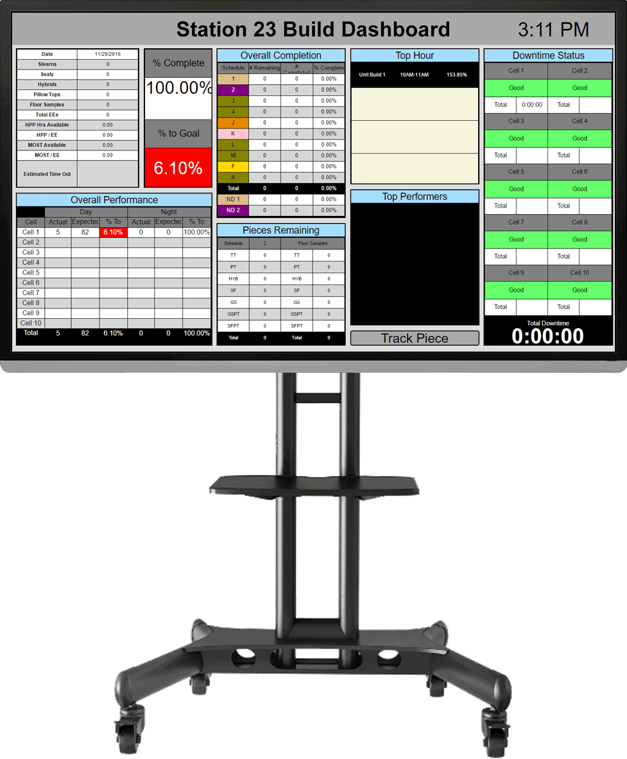
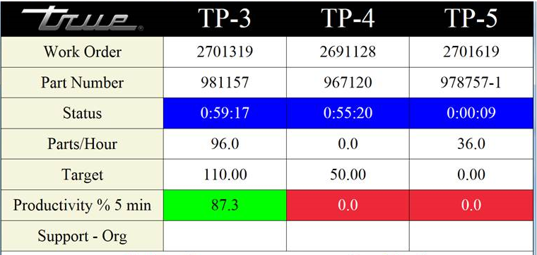
Innovations in Visual Management
New Andon Technology Un- Paralleled Performance Visibility
LED Light is completely Programmable
1
Factory Floor Communication • Andons • Real Time Performance Screens • Visual Factory • Automated Data Capture • OEE

Slide 18

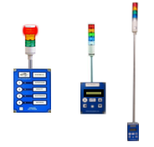
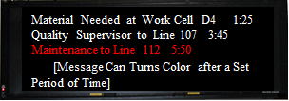
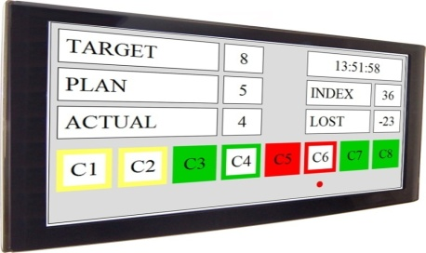
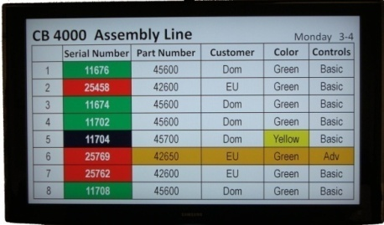
Completely Integrated Visual Andon Systems
A New Dimension in Visual Communications for the Production Floor - Virtual Panel IV Display Software
Communications Support Request
Fully Integrated Andon Systems
From Input Modules to Displays
Input Modules
Production Activity Status
Virtual Panel IV Software
New Panel Software
Systematic Panel Generation Process
Wizard Guides Panel Development
Significant Reduction in Panel Creation Time
Improved Options in Panel Development Choices
Easy Correction Feature
Production Schedule
VP IV Software Right Sizes to Device – Same Screen on a Smart Phone as Large Screen Display
Factory Floor Communication • Andons • Real Time Performance Screens • Visual Factory • Automated Data Capture • OEE

Slide 19
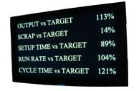
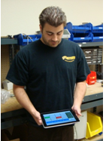
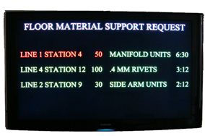
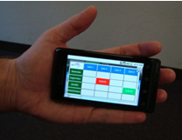
Visual Management – Real Time Production Status Visibility
Linking Communications With Visual & Audio Andon Notification
Un-Paralleled Performance Visibility
Line Performance
Operator / Cell / Equipment Performance
Android & iPad Tablets
Production Floor - White Boards
Material Support
Smart Phone KPI’s
Factory Floor Communication • Andons • Real Time Performance Screens • Visual Factory • Automated Data Capture • OEE

Slide 20
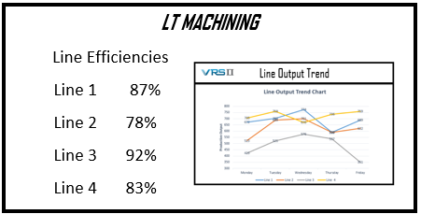
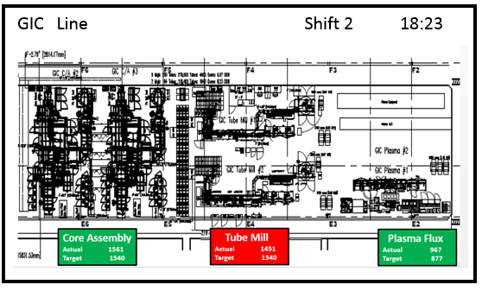

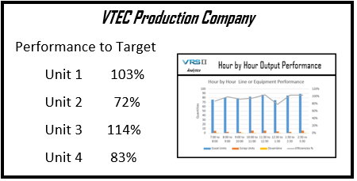



Visual Management
Updating Graphs & Real Time Performance Information
Unique Visual Management Solutions
Factory Floor Communication • Andons • Real Time Performance Screens • Visual Factory • Automated Data Capture • OEE

Slide 21










Virtual Panel IV Software
Andon – Messaging- Performance – Plant Layout – Informational
VP IV Software
Multiple Layout Options / Flexibility
• Type of Information Displayed
Plant Wide Information Messages
Factory Floor/ Line Performance Status
Real Time Performance Status
• What is Displayed
Text, Images, Scrolling Messages, Counts, Duration
Calculations, Conditional Messages, States, Formulas
• How Information is Displayed
Choose Font Size, Font Types, Font Color, Flashing
Panel or Flashing Letters, Real Time Update Rates
• Where / Sequence of Information
Target Specific Areas
Entire Plant
• User Friendly Tools –On Line
Interactive On-Line Session
Design Your Own Screen Layouts
• Start With Example Templates
Andons / Messaging / Informational / Performance / Combo
• Using Step by Step Wizards
Develop Screen Layouts
Process Takes 20 Minutes
Final Layout that Fits Your Needs
• Alternative - Developing Custom Screens Layout Solutions
Andons
Messaging
Informational
Performance
Combo
Plant Layouts
Factory Floor Communication • Andons • Real Time Performance Screens • Visual Factory • Automated Data Capture • OEE

Slide 22






VersaCall Reporting Software II
Software That Produces Trend and Comparison Graphs & Reports That Are Easy to Create and Change
Template Approach Provides Rapid Report Generation
Other Features
• Automatic Report Generation Feature
Reports Automatically Created for Shift , Day , Week - Sent Directly to Your E-mail
• Clear /Concise Graphs & Report Formats
Immediately Spot Issues & Root Causes – Simple Red/ Yellow / Green Designations
• Financial Performance Impacts Feature
Reports that Profile the Cost of Downtime & the Cost of Scrap
• Configure Custom Reports & Graphs
Adding In Your Own Title & Logo
• Apply Standards & Target References
Pull Reference Standards for Existing Databases or Look Up Tables Using Data Look Up Manager
• Step by Report Generation Using Wizards & Choosing Templates
Factory Floor Communication • Andons • Real Time Performance Screens • Visual Factory • Automated Data Capture • OEE

Slide 23




Primary Applications
1
Andons & Communications
Audio & Visual Andons
Immediate Communications of Issues
Wired & Wirelessly Activated Modules
Machine Monitoring Applications
Captures Lot Number or Production Run Performance Information
Captures Scrap by Reason Code / Downtime by Reason Code
Moving Assembly Line
Simple – Operator Input
Measures Each Segments Performance
Identifies Pacing Segment
Stationary Assembly Operations
Measures Assembly Activity Against Standards
Visibility Status of Assembly Activity
Immediate Communications of Issues
OEE
Complete System – Data Capture to Reporting
Eliminates Manual Data Collection
Critical Visibility for Addressing Issues
Factory Floor Communication • Andons • Real Time Performance Screens • Visual Factory • Automated Data Capture • OEE

Slide 24










Moving Forward - Identifying Your Application
Step 1 - Start Small - Identify One or Two Critical Problem Areas
Step 2 - Clearly Identify the Results You Want To Achieve - Define Your System Solution – Metric Visibility
Visual Performance Visibility
Trend & Analysis Reports and Graphs - Performance Information That Makes a Difference
Step 3 - Work with VersaCall to Develop an Application Profile
Lay Out a Solution for Addressing the Problem Areas - Including the Modules & Financial Justification
Also Installation & Configuration Packages Available
Messaging
Performance
Information
Andons
Design You Own Layout
Downtime
Communications
Performance
Trends
Download to Excel
For Developing a System Solution – We want to start where you want to end.
Factory Floor Communication • Andons • Real Time Performance Screens • Visual Factory • Automated Data Capture • OEE

